Slide 1
What is OLAP (Online Analytical Processing)?
OLAP stands for On-Line Analytical Processing. OLAP is a classification of software technology which authorizes analysts, managers, and executives to gain insight into information through fast, consistent, interactive access in a wide variety of possible views of data that has been transformed from raw information to reflect the real dimensionality of the enterprise as understood by the clients.
OLAP implement the multidimensional analysis of business information and support the capability for complex estimations, trend analysis, and sophisticated data modeling. It is rapidly enhancing the essential foundation for Intelligent Solutions containing Business Performance Management, Planning, Budgeting, Forecasting, Financial Documenting, Analysis, Simulation-Models, Knowledge Discovery, and Data Warehouses Reporting. OLAP enables end-clients to perform ad hoc analysis of record in multiple dimensions, providing the insight and understanding they require for better decision making.

Slide 2
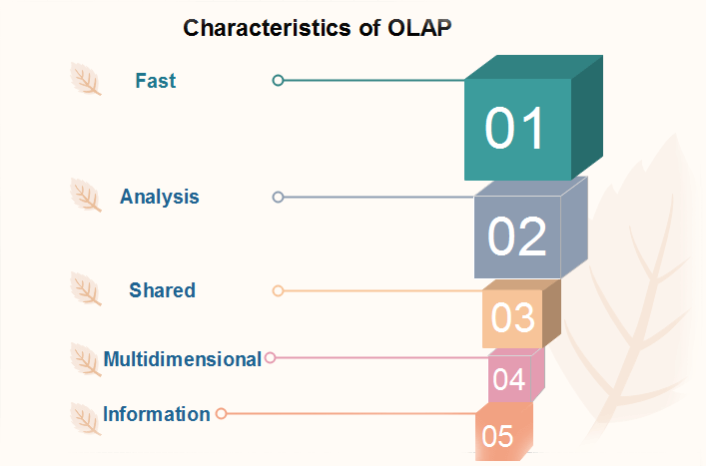
Characteristics of OLAP
In the FASMI characteristics of OLAP methods, the term derived from the first letters of the characteristics are:

Slide 3
Fast
It defines which the system targeted to deliver the most feedback to the client within about five seconds, with the elementary analysis taking no more than one second and very few taking more than 20 seconds.
Analysis
It defines which the method can cope with any business logic and statistical analysis that is relevant for the function and the user, keep it easy enough for the target client.

Slide 4
Share
It defines which the system tools all the security requirements for understanding and, if multiple write connection is needed, concurrent update location at an appropriated level, not all functions need customer to write data back, but for the increasing number which does, the system should be able to manage multiple updates in a timely, secure manner.
Multidimensional
This is the basic requirement. OLAP system must provide a multidimensional conceptual view of the data, including full support for hierarchies, as this is certainly the most logical method to analyze business and organizations.
Information
The system should be able to hold all the data needed by the applications. Data sparsity should be handled in an efficient manner.

Slide 5
The main characteristics of OLAP are as follows:
Multidimensional conceptual view: OLAP systems let business users have a dimensional and logical view of the data in the data warehouse. It helps in carrying slice and dice operations.
Multi-User Support: Since the OLAP techniques are shared, the OLAP operation should provide normal database operations, containing retrieval, update, adequacy control, integrity, and security.
Accessibility: OLAP acts as a mediator between data warehouses and front-end. The OLAP operations should be sitting between data sources (e.g., data warehouses) and an OLAP front-end.
Storing OLAP results: OLAP results are kept separate from data sources.
Uniform documenting performance: Increasing the number of dimensions or database size should not significantly degrade the reporting performance of the OLAP system.

Slide 6
Benefits of OLAP
OLAP holds several benefits for businesses: -
OLAP helps managers in decision-making through the multidimensional record views that it is efficient in providing, thus increasing their productivity.
OLAP functions are self-sufficient owing to the inherent flexibility support to the organized databases.
It facilitates simulation of business models and problems, through extensive management of analysis-capabilities.
In conjunction with data warehouse, OLAP can be used to support a reduction in the application backlog, faster data retrieval, and reduction in query drag.

Slide 7
Data Cube
When data is grouped or combined in multidimensional matrices called Data Cubes. The data cube method has a few alternative names or a few variants, such as "Multidimensional databases," "materialized views," and "OLAP (On-Line Analytical Processing)."
The general idea of this approach is to materialize certain expensive computations that are frequently inquired.
Data cube method is an interesting technique with many applications. Data cubes could be sparse in many cases because not every cell in each dimension may have corresponding data in the database.
A data cube enables data to be modeled and viewed in multiple dimensions.

Slide 8
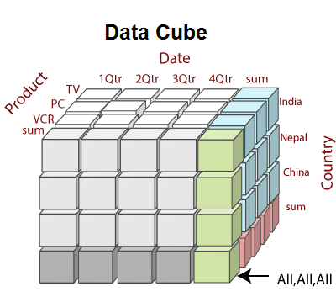
Dimensions are a fact that defines a data cube. Facts are generally quantities, which are used for analyzing the relationship between dimensions.

Slide 9
Types of Data Cube
There are two types of Data cubes which are used mostly in business or enterprises:
Multidimensional Data Cube (MOLAP)
As its name suggests Multidimensional Data cube is used mostly in the business requirement where there are huge sets of data. Products developed and follow involves the structure of MOLAP which has a multidimensional array format.
This structure helps in improving the huge data set with a sparser and an increased level of MOLAP. From this, we can come into a fact that this will not represent any specific data or clustered data value from a data set.

Slide 10
2. Relational Data Cube (ROLAP)
It is also another category of data analysis data cube which religiously follows the relational database model.
If we compared to the Multi-dimensional data cube, then it possesses double the number of relational tables to specify the dimensions with data sets and requirements.
Each of these tables contains a specific view which is called as a cuboid.

Slide 11
Benefits
Increases the productivity of an enterprise.
Improves the overall performance and efficiency.
Representation of huge and complex data sets get simplified and streamlined.
Huge database and complex SQL queries are also manageable.
Indexing and ordering provides the best set of data for analysis and data mining techniques.
Faster and easily accessible as It will posses pre-defined and pre-calculated data sets or data cubes.
Aggregation of data makes access to all data very fast at each micro-level which ultimately leads to easy and efficient maintenance and reduced development time.
OLAP will help in getting Fast Response time, Fast curve of Learning, versatile environment, reach to a wide range of reach to all applications, need of resources for deployment and less wait time with a quality result.

